Slide 1
Internet of Things (IoT): Connecting Our World
Transforming Industries and Daily Life

Slide 2
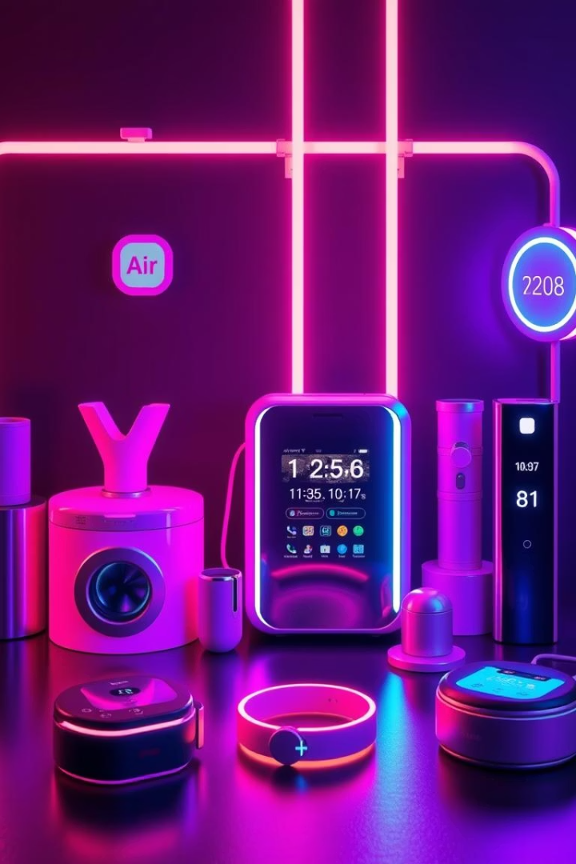
What is IoT?
Definition
Function
Network of physical objects with sensors and software
Enables data exchange between devices and systems
Examples
Smart homes, wearables, industrial sensors

Slide 3
The IoT Ecosystem
Components
Key Players
Data Flow
Devices
Device manufacturers
Device → Gateway → Cloud → User
Connectivity
Network providers
Data processing
Software developers
User interface

Slide 4
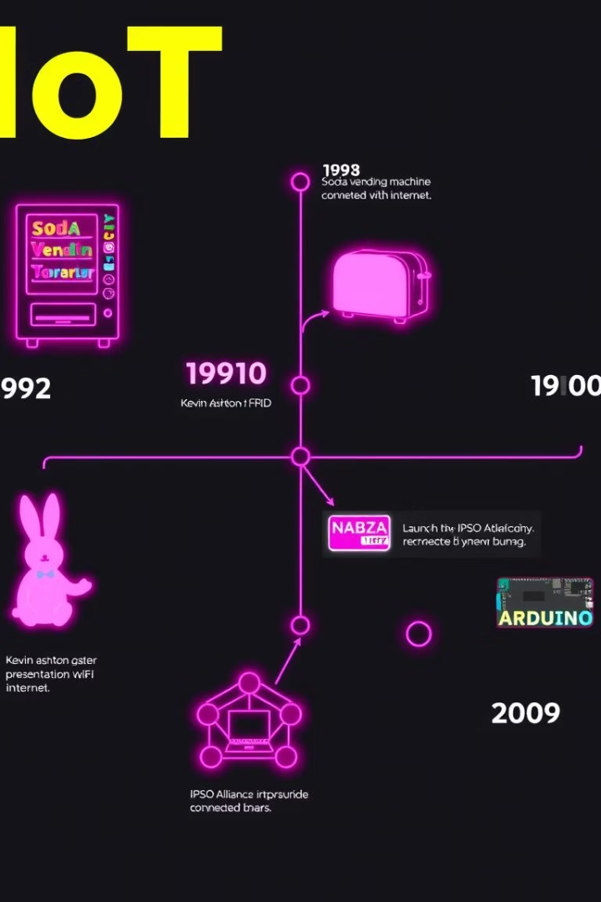
History of IoT
1
1982
Coke machine at CMU as first IoT device
2
1999
Kevin Ashton coins "Internet of Things" at P&G
3
2008-2009
More devices than people connected worldwide

Slide 5
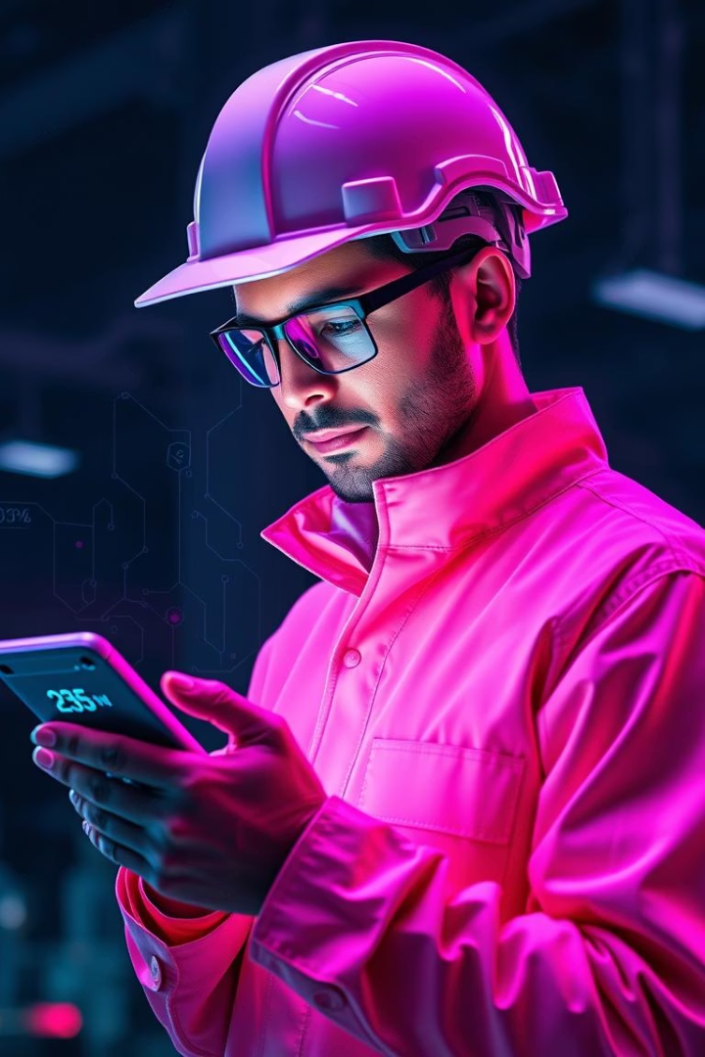
Importance of IoT
Efficiency
Boosts productivity across diverse industries
Decision-Making
Real-time data enables smarter choices
Customer Experience
Personalized services improve satisfaction
New Business Models
Creates fresh revenue streams and opportunities

Slide 6
Key Characteristics of IoT
Connectivity
Intelligence
Scalability
Security
Devices connect seamlessly to networks
Collects, analyzes, and acts on data
Supports large, growing numbers of devices
Protects data and devices from threats

Slide 7
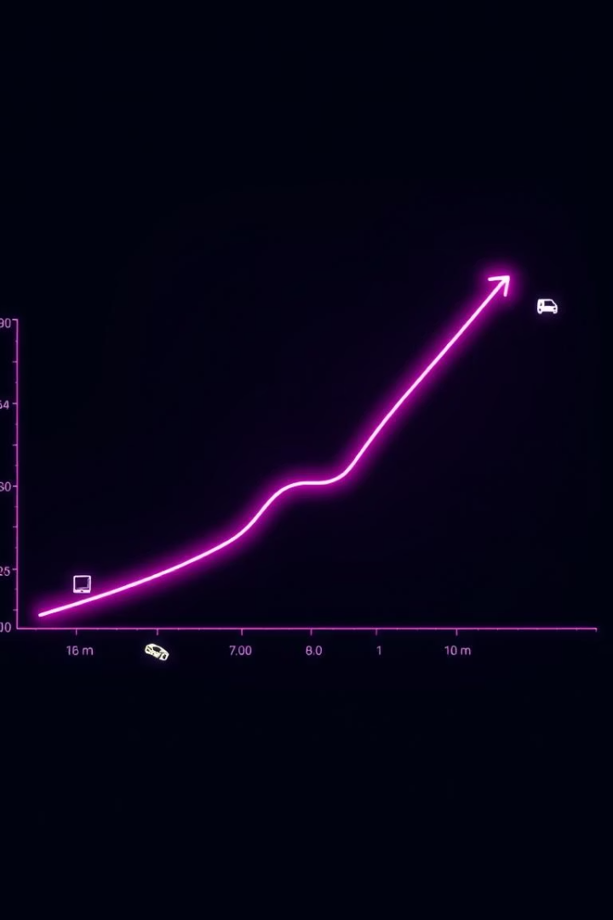
Fun Fact & Inspiring Quote
Fact
Over 75 billion IoT devices expected by 2025
Quote
"The Internet of Things is not a concept; it is a network." - Kevin Ashton

Slide 8
IoT Architecture Overview
Devices
Sensors and actuators gather and interact
Edge
Pre-processing and filtering data close to source
Cloud
Data storage, analysis, and application services

Slide 9
Sensors & Devices
Temperature
Pressure
Light
Motion
Actuators

Slide 10
Connectivity in IoT
Wi-Fi
Cellular (4G/5G)
LoRaWAN & Zigbee
High bandwidth, short range, ideal for smart home devices.
Wide area coverage, higher power use; great for fleet tracking.
Low power, long range; perfect for smart agriculture sensors.

Slide 11
Data Processing
Edge Computing
Cloud Computing
Data Analytics
Processes data near source, reducing latency. Example: Security cameras.
Centralized storage and analytics via AWS, Azure IoT Hub.
Transforms raw data into actionable insights, enabling predictive maintenance.

Slide 12
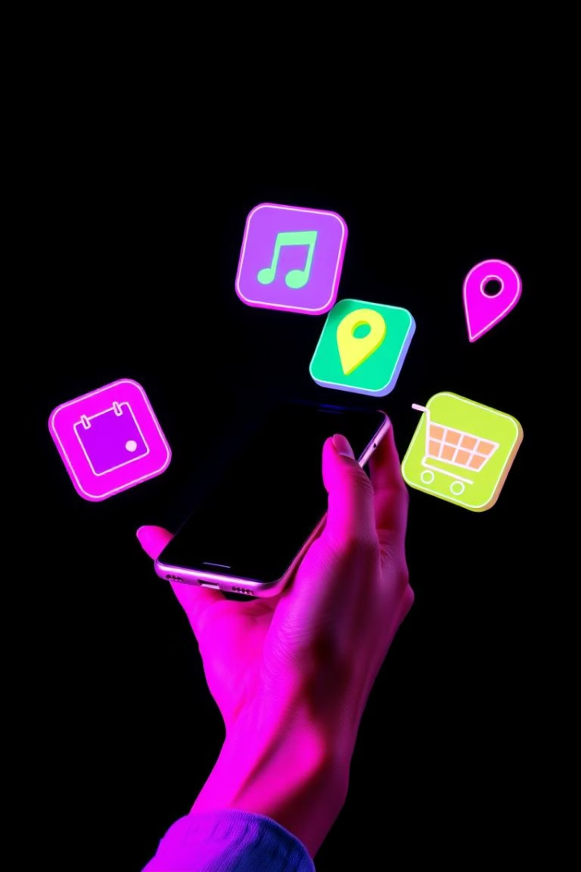
User Interaction
Mobile Apps
Voice Assistants
Dashboards
Control and monitor IoT devices like smart lighting from anywhere.
Hands-free control using Alexa, Google Assistant voice commands.
Real-time data visualization for energy use and device status.

Slide 13
IoT Workflow Diagram
Sensor
Collects environment data
Connectivity
Transmits data securely
Data Processing
Analysis and decision-making
User Interaction
User controls and monitoring
Action/Feedback
Automated system response

Slide 14
Smart Homes
Smart Thermostats
Smart Lighting
Security Systems
Reduce heating bills by 10-12%, cooling by 15% (e.g., Nest, Ecobee)
Philips Hue holds 50% of the smart lighting market share.
Ring installations lowered burglaries by 25% in affected neighborhoods.

Slide 15
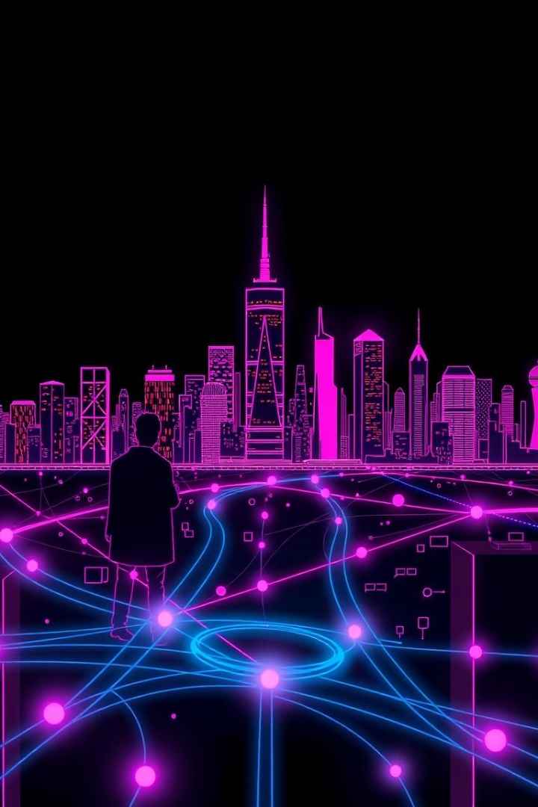
Smart Cities
Traffic Management
Waste Management
Pilot programs reduced congestion by 20% (e.g., Los Angeles)
Barcelona cut waste collection costs by 30% using IoT.
Environmental Monitoring
Real-time air quality data helps improve public health.

Slide 16
Healthcare (IoMT) & Agriculture
Healthcare
Agriculture
Remote patient monitoring
Precision farming with soil moisture sensors
Wearable health trackers
Drone-based crop monitoring
20% reduction in hospital readmissions (2023 study)
15% increase in crop yields using precision irrigation

Slide 17
Industry 4.0
Predictive Maintenance
Automated Processes
Robots efficiently manage assembly lines.
Downtime reduced by 25% in manufacturing plants.
Supply Chain Optimization
Real-time tracking improves efficiency by 20%.

Slide 18
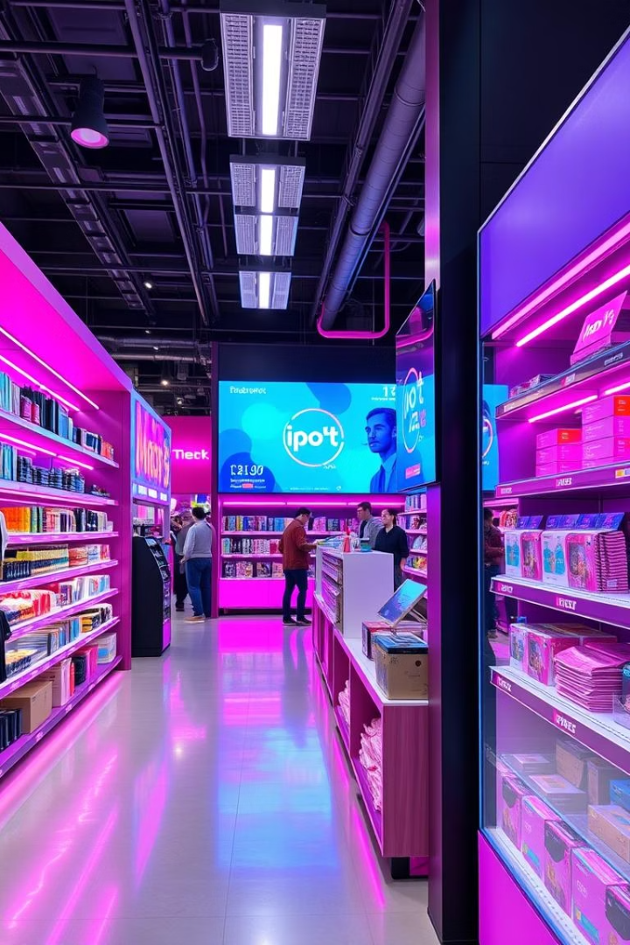
Retail: Revolutionizing Customer Experience
Smart Shelves
Personalized Shopping
Real-time inventory monitoring and automated ordering systems enhance stock management.
Location-based offers via beacons lift conversions by 80% through tailored promotions.
Enhanced Security
Smart surveillance reduces shrinkage by 30%, securing store assets effectively.
Examples include Amazon Go’s checkout-free stores and Kroger EDGE systems. Retail IoT market hits $94.44B by 2025.

Slide 19
Transportation: Smarter, Safer, Efficient
Fleet Management
Autonomous Vehicles
Smart Traffic
Logistics Optimization
Real-time tracking and predictive maintenance achieve 15% cost savings.
Sensor data improves navigation and safety; Tesla leads innovations.
Optimized flow reduces congestion and improves travel times by 20%.
Package tracking and delivery routes enhance efficiency, e.g., FedEx SenseAware.
Over $80B invested in autonomous driving technologies in 2023.

Slide 20
Environmental Applications: Monitoring & Sustainability
Air Quality
Water Management
Wildlife Tracking
Pollution monitoring with alerts, powered by BreezoMeter data.
Leak detection and optimized usage reduce water waste by 10%.
Conservation efforts use IoT for data analysis and monitoring, e.g., WWF.
Precision Agriculture
Optimized irrigation boosts crop yields by 20% sustainably.
Smart agriculture solutions attracted $6.2B investment in 2023.

Slide 21
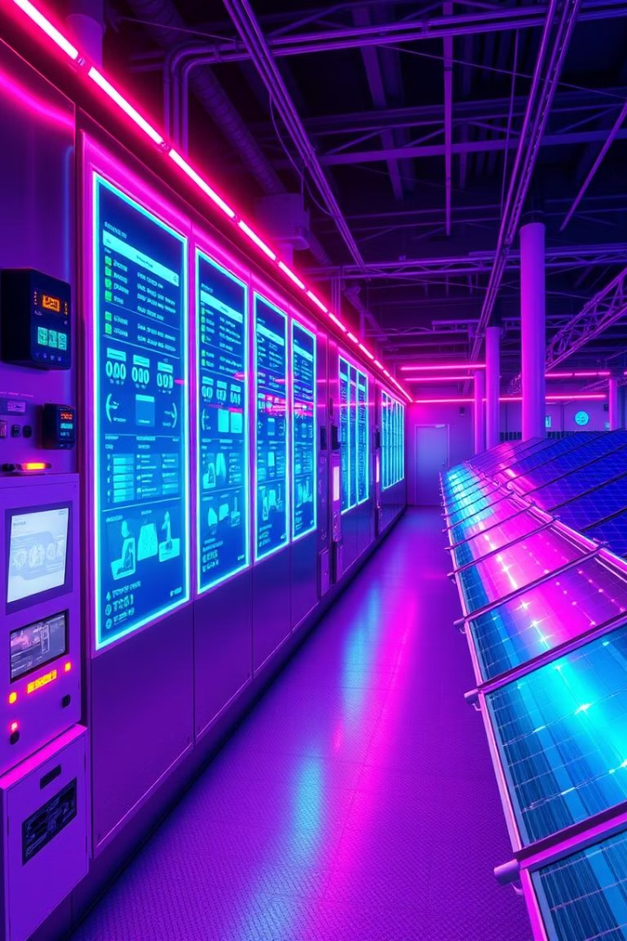
Energy: Smart Grids & Efficiency
Smart Grids
Enable real-time monitoring and optimized power distribution, gaining 12% efficiency.
Smart Homes
Automated energy management via devices like Nest thermostats reduces usage.
Predictive Maintenance
Monitors equipment health, preventing failures and saving 10-15% costs.
Renewables
Optimizes output and storage in solar and wind farms for stability.
Smart grid market projected to reach $61.3B by 2028.

Slide 22
Innovative IoT Use Cases: Beyond the Horizon
Healthcare
Smart Cities
1
Remote patient monitoring and smart implants improve care.
Optimize infrastructure and citizen services, example: Barcelona.
2
Wearables
4
Industrial IoT
Fitness and health tracking empower personal wellness.
3
Automation and predictive maintenance enhance manufacturing.
Healthcare IoT market expected to hit $187.6B by 2028.

Slide 23
Application Recap: Key Benefits
Cost Reduction
Increased Efficiency
Minimizes waste and improves maintenance.
2
Simplifies processes and maximizes resources.
1
Improved Decision-Making
3
Leverages real-time data and predictive analytics.
New Revenue Streams
5
Enhanced Customer Experience
Unlocks innovative products and subscriptions.
4
Delivers personalized, proactive services.

Slide 24
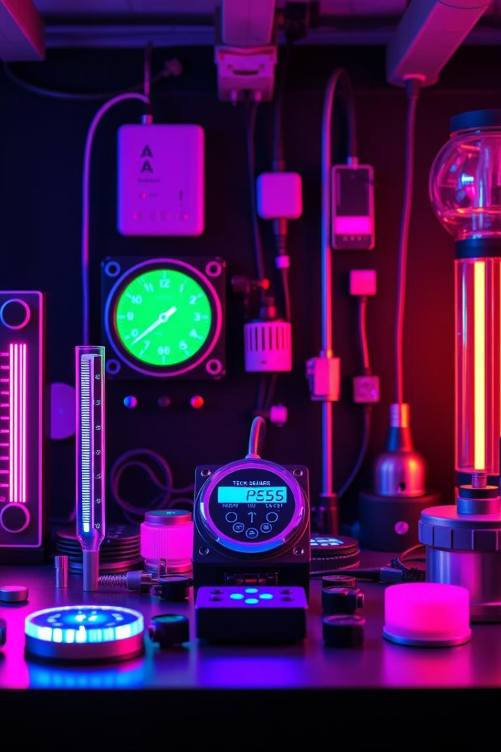
Sensors Overview: The Eyes & Ears of IoT
Sensor Types
Temperature, Pressure, Humidity, Light, Motion, Gas
Key Features
Accuracy, Sensitivity, Low Power, Small Size, Cost
Leading Brands
Bosch Sensortec, STMicroelectronics
Recent Advances
AI-powered sensors with built-in analytics for smarter data

Slide 25
Connectivity Standards & Edge vs Cloud Computing
1
Connectivity Protocols
Bluetooth: short-range, low power, e.g., wearables
Wi-Fi: medium-range, high bandwidth, e.g., smart homes
Cellular (4G/5G): long-range, mobile, e.g., fleet tracking
LoRaWAN: long-range, low power, e.g., smart agriculture
Zigbee: mesh network, low power, e.g., industrial automation
2
Edge Computing
Processes data near the source, reducing latency and improving security.
3
Cloud Computing
Centralized storage and analytics, offering scalability and centralized control.
4
Example
Smart factories use edge for real-time control and cloud for analysis.

Slide 26
AI & ML in IoT
Enhanced data analysis
Manufacturing savings
AI/ML power predictive insights and smart automation.
Predictive maintenance reduces costs by 30%.
Smart home efficiency
Security improvements
Energy use optimized by up to 20% with AI.
Real-time anomaly detection strengthens defenses.

Slide 27
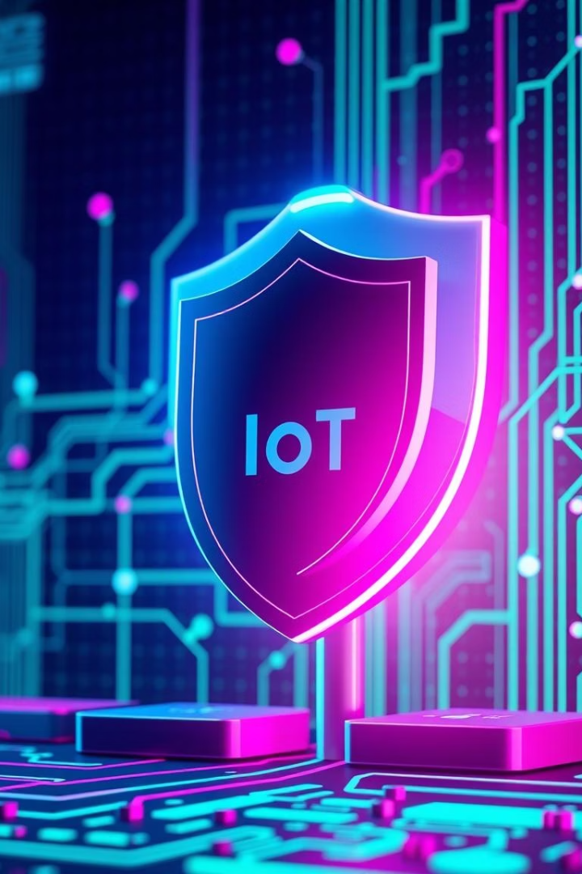
Security Technologies
Strong Encryption
AES-256 and TLS 1.3 secure all communications.
Blockchain Authentication
Ensures device identity and tamper resistance.
Intrusion Detection
Monitors network traffic for suspicious activity.
Secure Boot
Verifies firmware integrity before startup.

Slide 28
Open Platforms & Protocols
Communication Protocols
Open Source Platforms
Data Standards
MQTT, CoAP, HTTP facilitate device messaging
Eclipse IoT and others foster collaboration and innovation.
JSON and XML ensure interoperability across devices.
Standard protocols enable wide adoption
Reduce vendor lock-in with transparent frameworks.

Slide 29
Security & Privacy Challenges
Data Breaches
Unauthorized access threatens user data.
Weak Credentials
Default passwords and firmware flaws create risks.
Botnet Threats
IoT devices exploited in attacks like Mirai botnet.
Privacy Risks
Extensive data collection enables profiling concerns.

Slide 30
Data Management Challenges
Massive Volumes
Real-time Processing
Zettabytes generated annually by IoT devices.
High speed data handling demands robust systems.
Scalable Infrastructure
Governance & Compliance
Efficient data platforms support ongoing growth.
Regulations like GDPR and CCPA must be followed.

Slide 31
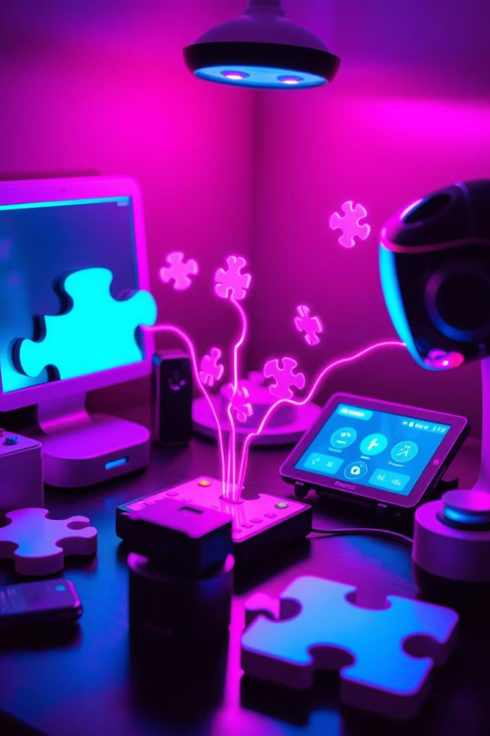
Interoperability Issues
Protocol Diversity
Multiple standards hinder seamless connections.
Integration Gaps
Difficulties combining various IoT ecosystems persist.
Semantic Challenges
Meaningful data exchange requires common frameworks.
Standardization Need
Unified standards will drive interoperability forward.

Slide 32
Power & Connectivity Issues
Battery Life Limits
Short device uptime restricts capabilities.
Low-Power Communication
Technologies like LoRaWAN and NB-IoT reduce consumption.
Connectivity Gaps
Remote areas often lack reliable network access.
Energy Solutions
Power harvesting boosts efficiency and autonomy.

Slide 33
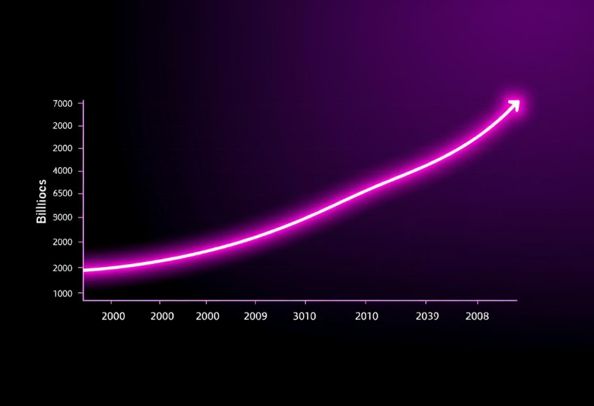
Regulation, Ethics & Growth Predictions
Regulation & Ethics
IoT Growth Projections
Data privacy rules demand strict compliance
75 billion devices expected by 2025 (Statista)
Ethical concerns over data use and consent
$1.6 trillion market value (IDC)
Liability for security flaws is critical
Surge in healthcare, manufacturing, smart cities
Clear regulatory frameworks needed worldwide
AI/ML and edge computing boost adoption

Slide 34
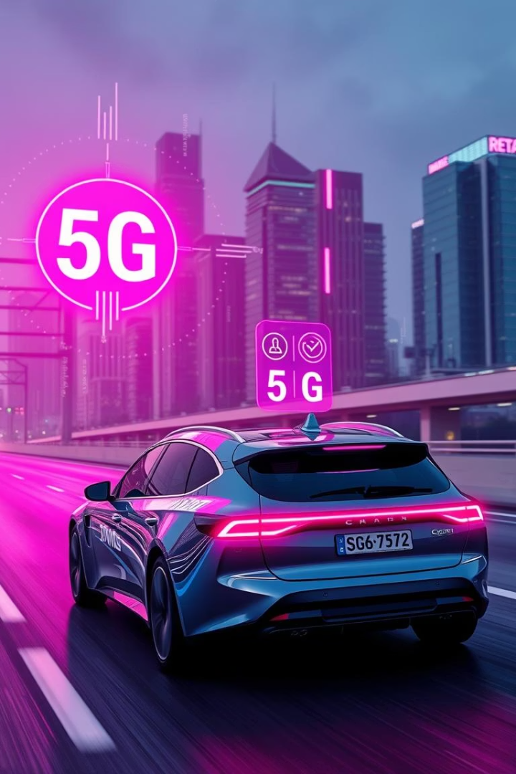
AI + 5G + IoT: The Perfect Storm
Synergistic Impact
Edge Computing
AI drives intelligence, 5G enables rapid data speed.
Real-time processing with ultra-low latency benefits industrial use.
Market Growth
AI + IoT market $25B+ by 2025, 5G at $668B by 2026.

Slide 35
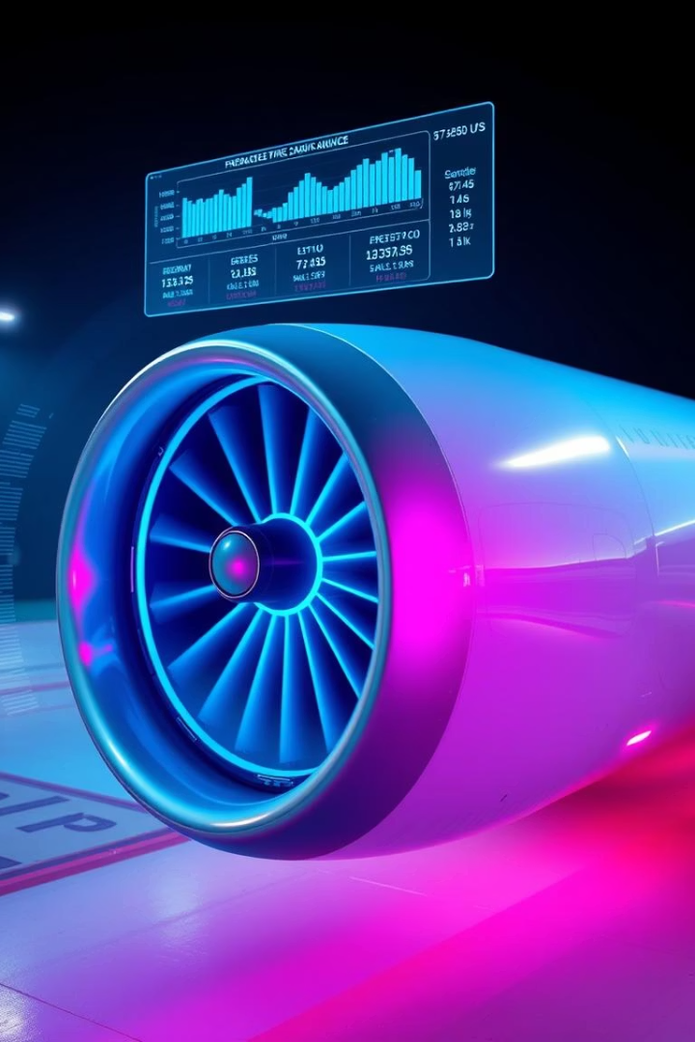
Digital Twins: Mirroring Reality
Definition
Applications
Virtual replicas of physical systems enabling detailed insights.
Used for predictive maintenance, simulation, and optimization.
Impact
GE Aviation saved $3B+ through digital twin technology.

Slide 36
Smart Everything Trend: Ubiquitous Connectivity
Smart Homes
Smart Cities
Smart Healthcare
Automated lighting & security
Traffic & waste management
Remote monitoring
Energy management systems
Public safety optimization
Telemedicine & personalized care

Slide 37
Vision for 2030: Hyper-Connected World
Trillions of Devices
Driving automation on a massive scale.
Personalized Insights
Data powers tailored experiences across sectors.
Ethical Focus
Prioritizing data privacy, security, and fairness.
Future Potential
Boosting sustainability, efficiency, and quality of life.

Slide 38
Summary of Key Points
2030 Vision
Smart Everything
Ubiquitous connectivity transforming everyday life.
Digital Twins
Enhancing convenience, safety, and operational efficiency.
AI + 5G + IoT
Optimize operations and reduce equipment downtime.
Enabling fast, intelligent real-time decisions.

Slide 39
Case Study: Real-Life IoT Success
John Deere IoT Sensors
Precision Agriculture
Results
Embedded on tractors for data-driven farming.
Optimizes planting, irrigation, and harvesting techniques.
20% yield increase
15% less water usage
$100M+ annual savings

Slide 40
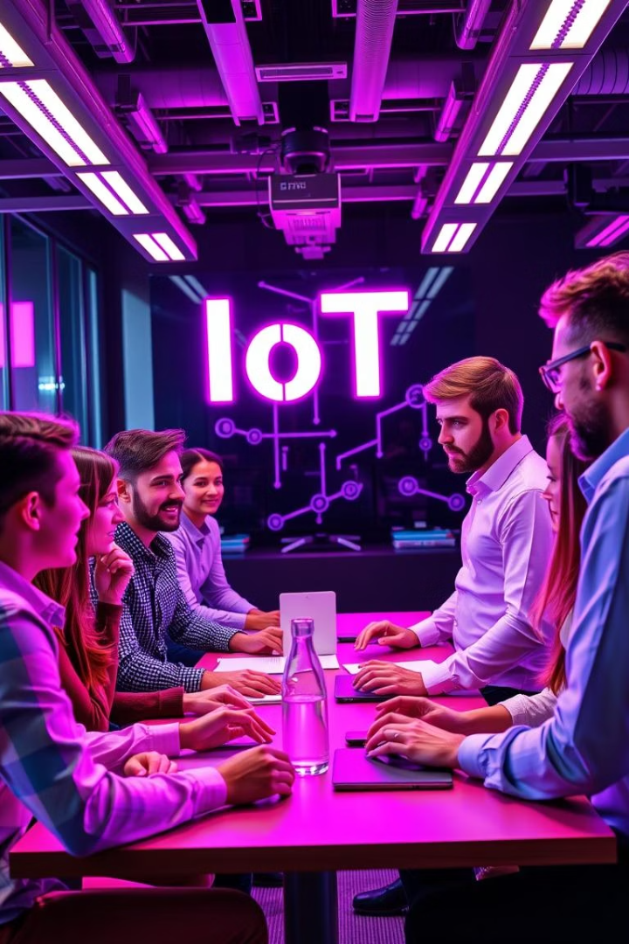
Quiz & Discussion
What challenges face IoT deployment?
How to ensure data privacy in a connected world?
What innovative IoT uses do you foresee?

Slide 41
Q&A
Your Questions?

Slide 42
Thank You!
Sahil Singh
Team RC
thesoulimortal0105@gmail.com
Rocket Codely

